Slide 1
Fraud Transacation Detection

Slide 2
Objective:
Credit card frauds are easy and friendly targets. E-commerce and many other online sites have increased the online payment modes, increasing the risk for online frauds. Increase in fraud rates, researchers started using different machine learning methods to detect and analyse frauds in online transactions. The main aim of the paper is to design and develop a novel fraud detection method for Transaction Data, with an objective, to analyse the past transaction details of the customers and extract the behavioural patterns.

Slide 3
Introduction:
Credit card generally refers to a card that is assigned to the customer (cardholder), usually allowing them to purchase goods and services within credit limit or withdraw cash in advance. Credit card provides the cardholder an advantage of the time, i.e., it provides time for their customers to repay later in a prescribed time, by carrying it to the next billing cycle.
Credit card frauds are easy targets. Without any risks, a significant amount can be withdrawn without the owner’s knowledge, in a short period. Fraudsters always try to make every fraudulent transaction legitimate, which makes fraud detection very challenging and difficult task to detect.
With different frauds mostly credit card frauds, often in the news for the past few years, frauds are in the top of mind for most the world’s population. Credit card dataset is highly imbalanced because there will be more legitimate transaction when compared with a fraudulent one.

Slide 4
Benefits:
Detection of frauds.
Analyse the past transaction details of the customers and extract the behavioural patterns.
Easily evaluate transaction is fraud or not

Slide 5
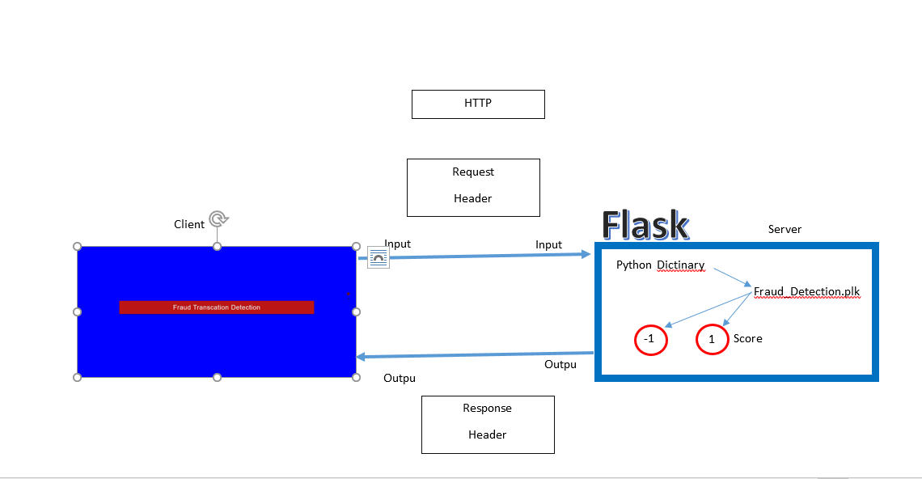
Architecture

Slide 6
Methodology:
Import all required libraries
Analysing Data
Vislalisiong the null values
Splitting data in Training and Testing sets
Feature scaling
KNN training
SVM training
Naive bayes training
Decision Tree training
Random forest training

Slide 7
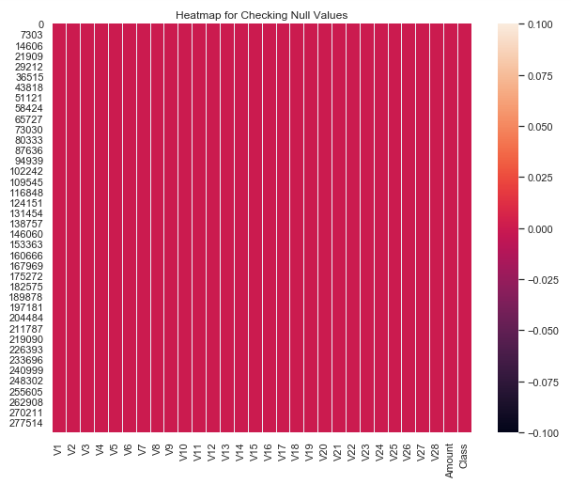
Visualizing the null values:

Slide 8
Model Training:
Data Export from Kaggle :
Data Preprocessing
Data Validation
Data Training

Slide 9
Model Selection –
By using algorithms “KNN”,“SVM” ,“Naïve bayes”, “Random Fores”. We calculate the scores for models and select the model with the best score. Similarly, the model is selected for each cluster. All the models for every cluster are saved for use in prediction

Slide 10
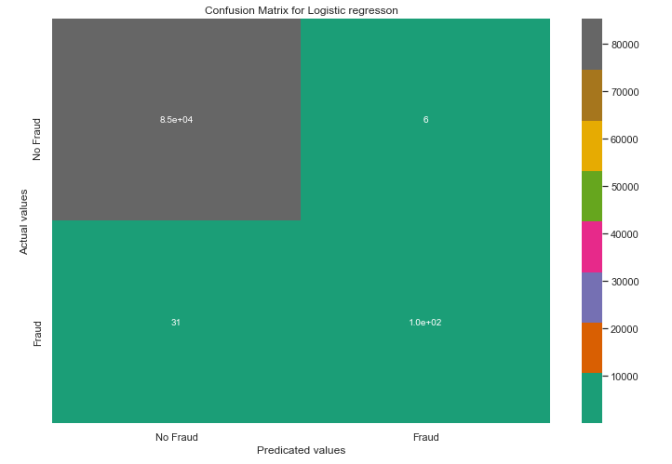
Prediction:
The testing files are shared in the batches and we perform the same Validation operations ,data transformation and data insertion on them.

Slide 11
Special Thanks- Sudhanshu,Krish , iNeuron support team
Deigned by- Mohammad Danish
Diksha Sharma
Nitin kushwaha

Slide 12
Objective:
Development of a predictive model for monitoring fraud insurance claim for Private motor products . The model will determine whether a customer is placing a fraudulent insurance claim or not.
Benefits:
Detection of upcoming frauds.
Gives better insight of customers base.
Helps in easy flow for managing resources.
Manual inspection if fraud is identified .

Slide 13
Data Sharing Agreement :
Sample file name (ex fraudDetection_20062021_101010)
Length of date stamp(8 digits)
Length of time stamp(6 digits)
Number of Columns
Column names
Column data type

Slide 14
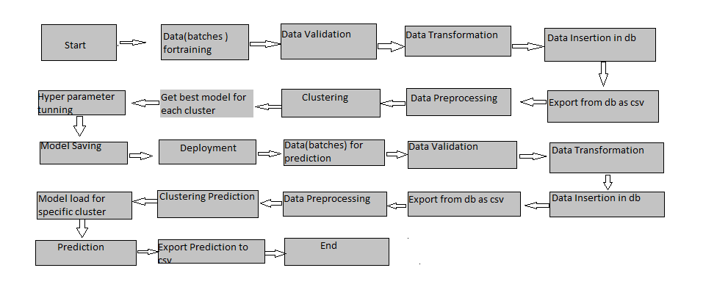

Slide 15
Data Validation and Data Transformation :
Name Validation - Validation of files name as per the DSA. We have created a regex pattern for validation. After it checks for date format and time format if these requirements are satisfied, we move such files to "Good_Data_Folder" else "Bad_Data_Folder.“
Number of Columns – Validation of number of columns present in the files, and if it doesn't match then the file is moved to "Bad_Data_Folder.“
Name of Columns - The name of the columns is validated and should be the same as given in the schema file. If not, then the file is moved to "Bad_Data_Folder".
Data type of columns - The data type of columns is given in the schema file. It is validated when we insert the files into Database. If the datatype is wrong, then the file is moved to "Bad_Data_Folder".
Null values in columns - If any of the columns in a file have all the values as NULL or missing, we discard such a file and move it to "Bad_Data_Folder".

Slide 16
Data Insertion in Database:
Table creation :- Table name “t_motorpv_fraud" is created in the database for inserting the files. If the table is already present then new files are inserted in the same table.
Insertion of files in the table - All the files in the "Good_Data_Folder" are inserted in the above-created table. If any file has invalid data type in any of the columns, the file is not loaded in the table

Slide 17
Model Training:
Data Export from Db :
The accumulated data from db is exported in csv format for model training
Data Preprocessing
Performing EDA to get insight of data like identifying distribution , outliers ,trend
among data etc.
Check for null values in the columns. If present impute the null values.
Encode the categorical values with numeric values.
Perform Standard Scalar to scale down the values.

Slide 18
Clustering –
KMeans algorithm is used to create clusters in the preprocessed data. The optimum number of clusters is selected by plotting the elbow plot, and for the dynamic selection of the number of clusters, we are using KneeLocator function. The idea behind clustering is to implement different algorithms on the structured data
The Kmeans model is trained over preprocessed data, and the model is saved for further use in prediction
Model Selection –
After the clusters are created, we find the best model for each cluster. By using 2 algorithms “SVM” and "XGBoost". For each cluster both the hyper tunned algorithms are used. We calculate the AUC scores for both models and select the model with the best score. Similarly, the model is selected for each cluster. All the models for every cluster are saved for use in prediction

Slide 19
Prediction:
The testing files are shared in the batches and we perform the same Validation operations ,data transformation and data insertion on them.
The accumulated data from db is exported in csv format for prediction
We perform data pre-processing techniques on it.
KMeans model created during training is loaded and clusters for the preprocessed data is predicted
Based on the cluster number respective model is loaded and is used to predict the data for that cluster.
Once the prediction is done for all the clusters. The predictions are saved in csv format and shared

Slide 20
Q & A:
Q1) What’s the source of data?
The data for training is provided by the iNeuron.ai .
Q 2) What was the type of data?
The data was numerical containing 31 features.
Q 3) What’s the complete flow you followed in this Project?
Refer slide 5th for better Understanding
Q 4) After the File validation what you do with incompatible file or files which didn’t pass the validation?
Files like these are moved to the Achieve Folder and a list of these files has been
shared with the iNeuron team and we removed the bad data folder.

Slide 21
Q 5) How logs are managed?
We are using different logs as per the steps that we follow in validation and
modeling like File validation log , Data Insertion ,Model Training log , prediction log
etc.
Q 6) What techniques were you using for data pre-processing?
Removing unwanted attributes
Visualizing relation of independent variables with each other and output variables
Checking and changing Distribution of continuous values
Removing outliers
Cleaning data and imputing if null values are present.
Scaling the data

Slide 22
Q 7) How training was done or what models were used?
Before diving the data in training and validation set we performed clustering over fit to divide the data into clusters.
As per cluster the training and validation data were divided.
The scaling was performed over training and validation data
Algorithms like Random classifier , logistic regression , SVM , XGBoost , were used based on the recall final model was used for each cluster and we saved that model .
Q 8) How Prediction was done?
The testing files are shared by the iNeuron team .We Perform the same life cycle till the data is clustered .Then on the basis of cluster number model is loaded and perform prediction. In the end we get the accumulated data of predictions

Slide 23
Q 9) What are the different stages of deployment?
When the model is ready we deploy it in Fire environment .Where SIT and UAT is performed over it.
Once We get Sign off from Fire we deploy in Earth and UAT is performed over it.
After getting the sign off from Earth we deploy in production

